Slide 1
Flex
https://css-tricks.com/snippets/css/a-guide-to-flexbox/

Slide 2
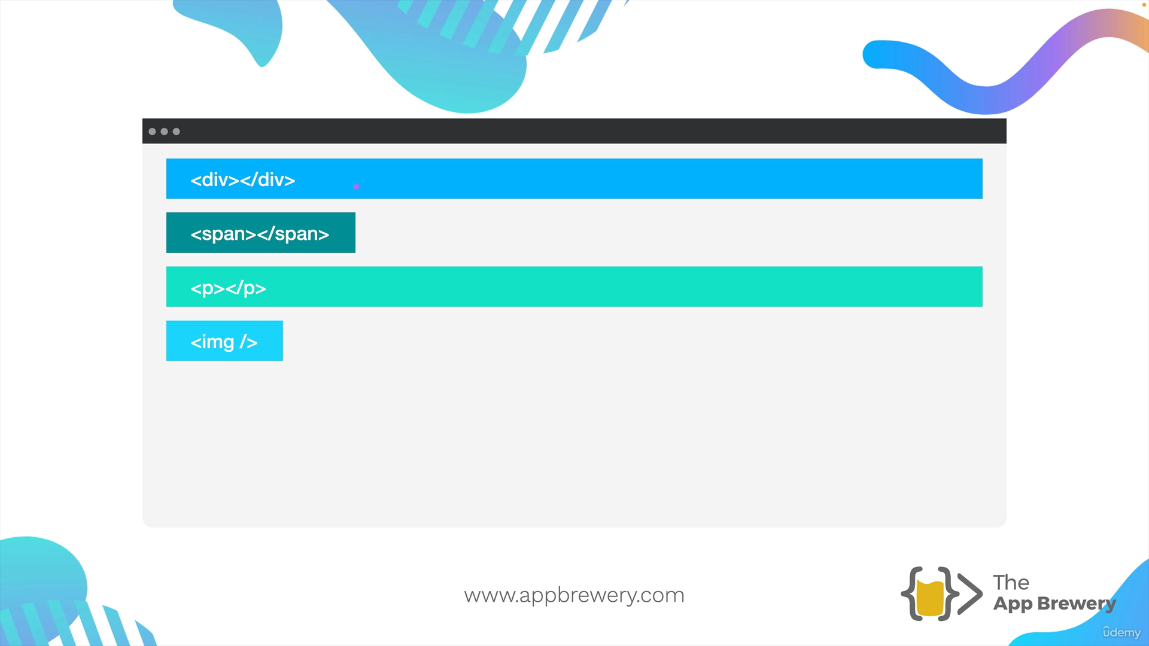
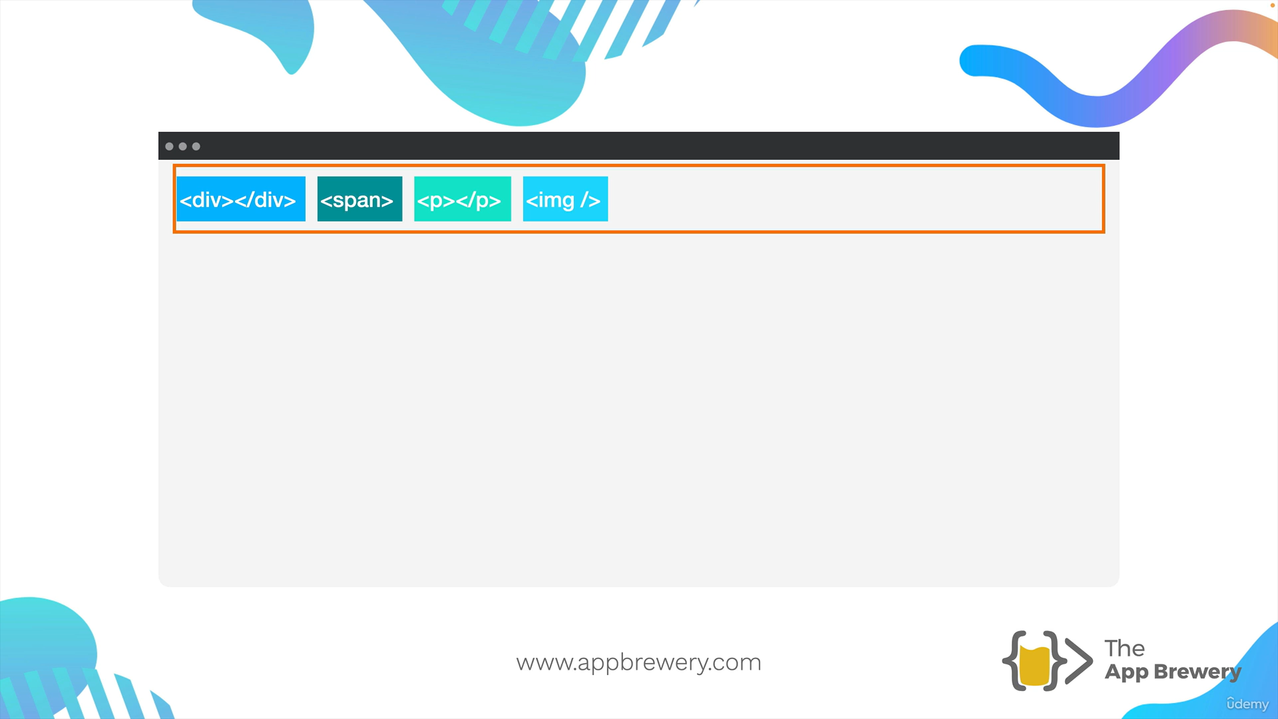
Display Flex
Gap property is used after flex box

Slide 3
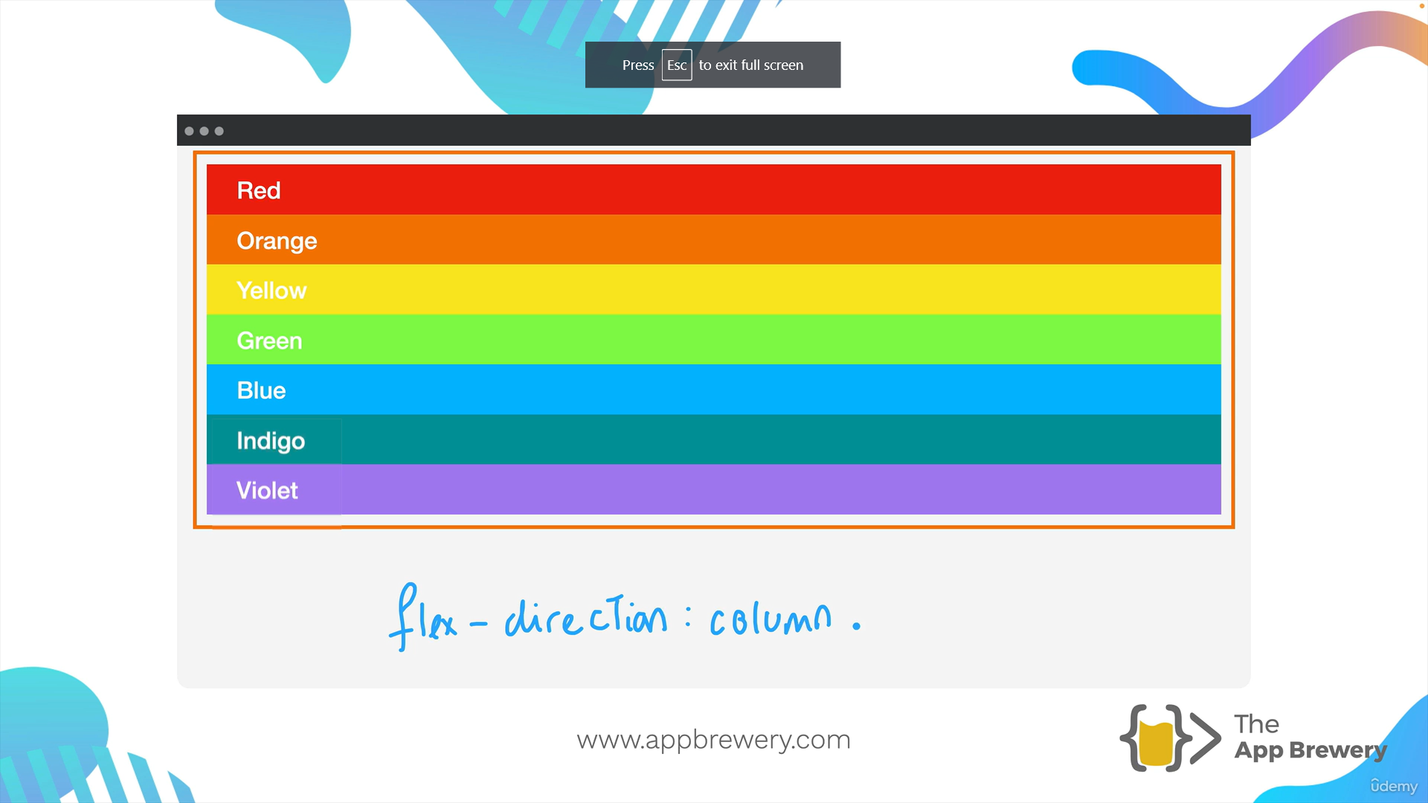
flex-direction : row (default) flex-direction : column

Slide 4
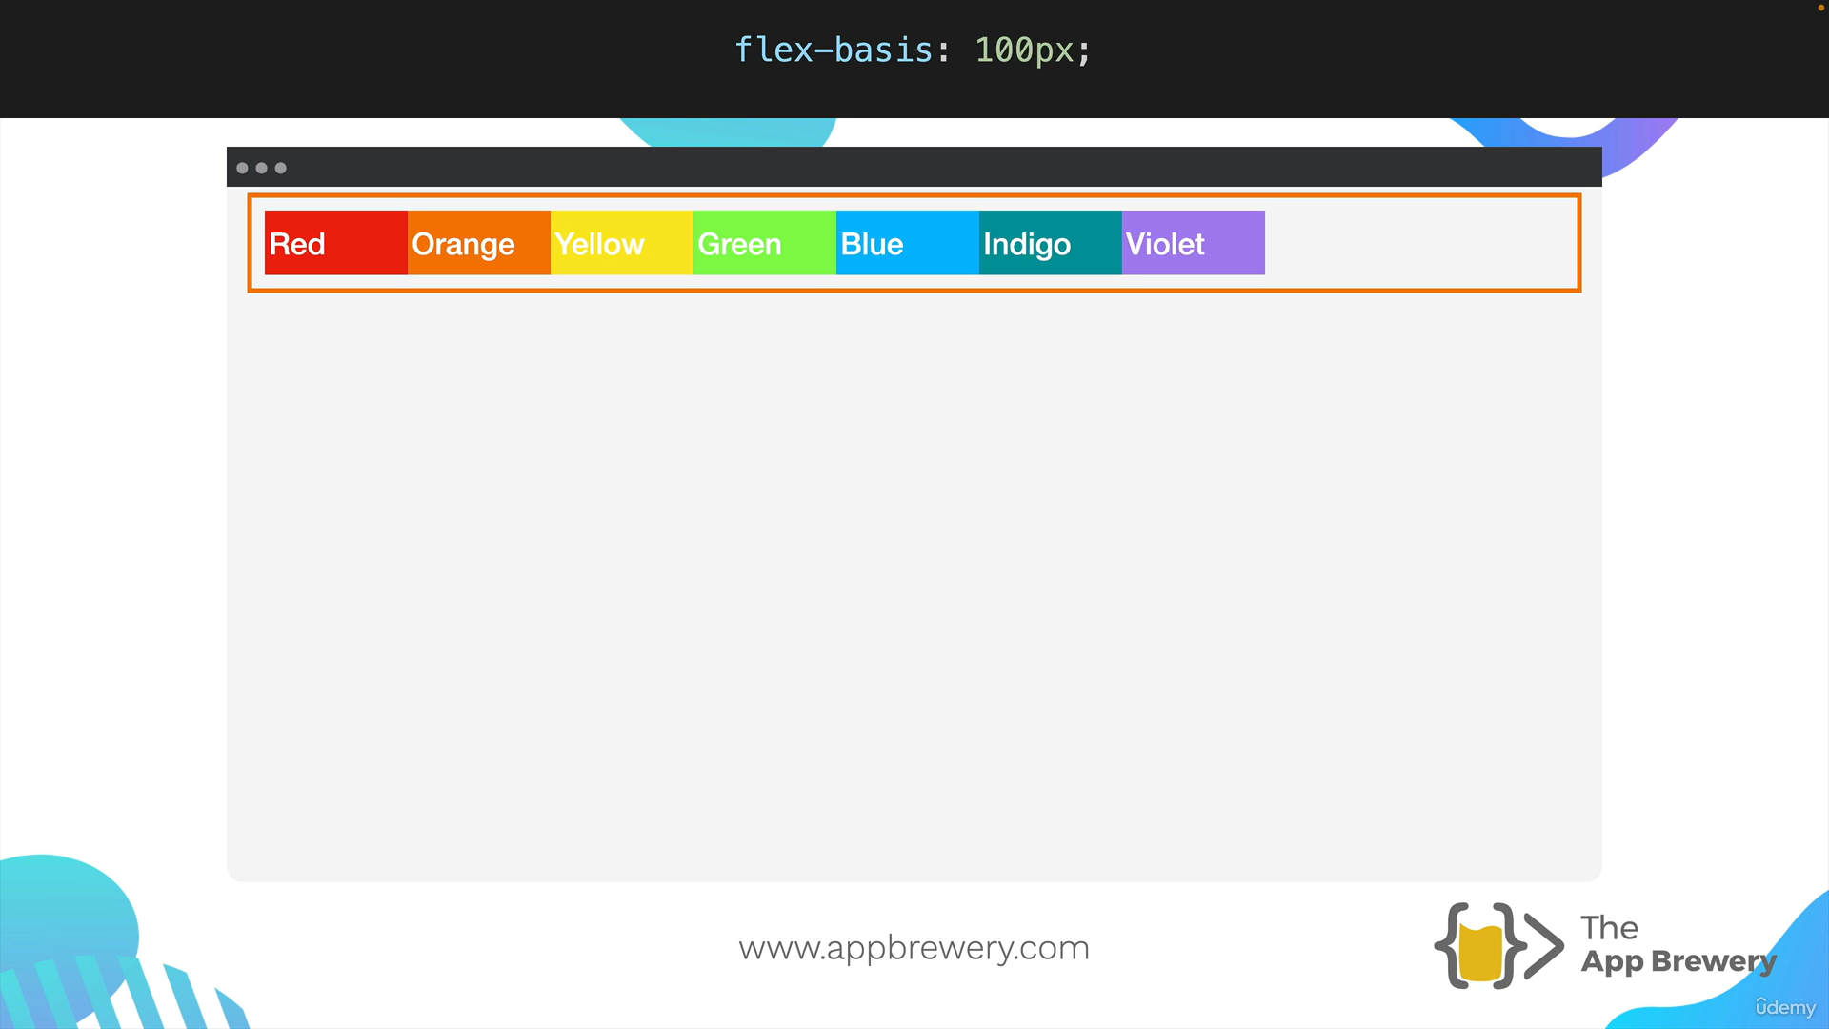
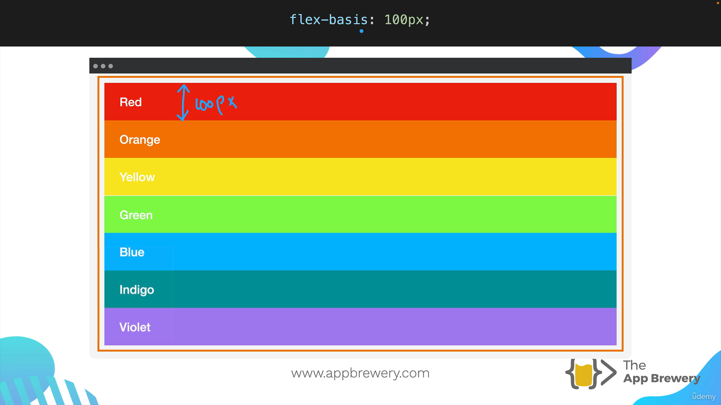
Flex-bASIS
Child Property

Slide 5
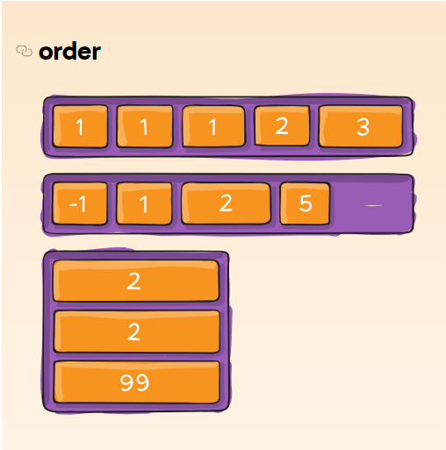
Order
Child Property

Slide 6
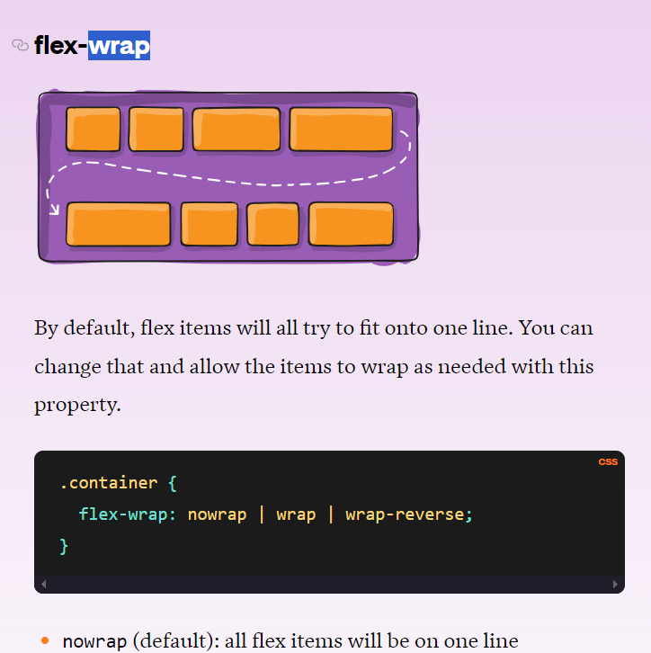
Flex-wrap
If flex-wrap;
✅align-content
❌ align-items

Slide 7
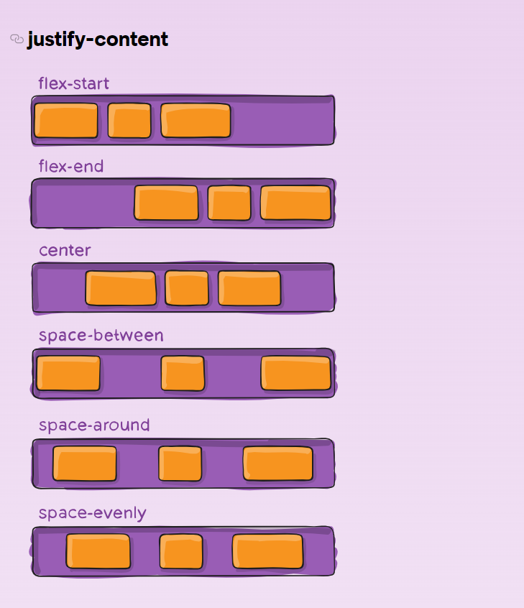
Justify-Content

